Slide 1

College of Osteopathic Medicine
Division of Academic Affairs
FY 2024 Planning and Budget Meeting

Slide 2
College of Osteopathic Medicine
Dean’s Office | Dean’s Office
Clinical Affairs | Educational Affairs | Biomedical Sciences
Clinical Education Clinical Skills Graduate Medical Education Osteopathic Principles and Practice Primary Care & Clinical Medicine SHSU Physicians Clinic | Assessment, Evaluation & Accreditation Medical Student Affairs Program Support and Resources | Clinical Anatomy Molecular and Cellular Biology Physiology and Pharmacology Office of Research
Notes:
Dean’s Office: Includes the dean, associate/assistant deans, administrative coordinators, director of operations and communications & events specialist.

Slide 3
FY 2023 Accomplishments
Priority 1: Prioritize Student Success and Student Access
  Worked with 4 different pipeline programs to prepare high school and undergraduate students to enter careers in medicine. (JAMP)
  Provided licensing exam resources (on-site and on-line)
  Granted travel awards for research distribution, national leadership roles, and advocacy opportunities
  Designed Learning Communities with faculty and staff who serve as mentors and advisors
  Trained tutors and managed the COM peer tutoring program
  Utilized a clinical skills training approach which includes Standardized Patients (SPs) and simulation to prepare students for clerkships.
  Provided career development programming for residency preparation

Slide 4
FY 2023 Accomplishments
Priority 2: Embody a Culture of Excellence
SHSU-COM is already one of the more competitive DO schools in the nation
  Average matriculant metrics of 506 MCAT/3.69 GPA.
  National average (2021) was 504 MCAT/3.56 GPA
38 highly qualified faculty who teach, mentor and advise our student doctors.
Inaugural class will complete their third-year clerkships Summer 2023.
  Outstanding evaluations from clinical rotations
  97.1% pass rate on their first Board examination
    3% higher than the national average
    Ranked in the top 20% out of all COMs
      (note: this is unofficial data with final verification in mid-2023)

Slide 5
FY 2023 Accomplishments
Priority 3: Elevate the Reputation and Visibility of SHSU
Established 7 regional clinical core sites in community-based, rural and underserved areas of East Texas for clinical education.
80 Signed affiliation agreements with 25 more pending approval
250 clerkship rotations and more than 650 credentialed preceptors
SHSU-COM partners with multiple local and national foundations
  Montgomery Emergency Medical Services, Texas Area Health Education Center (AHEC) East, Texas Rural Health Association, the American Heart Association, Meals on Wheels, Angel Reach's Transitional Living Program, Yes to Youth, the Montgomery County Foodbank, the Salvation Army, etc.

Slide 6
FY 2023 Accomplishments
Priority 4: Expand and Elevate our Service to the State and Beyond
Graduate Medical Education
Received a $5.7M federal grant from HRSA to launch a rural family medicine residency program in Huntsville, TX in July 2023.
Matched 4 residents into the Huntsville Memorial Hospital Program.
Several new rural and community-based residency programs currently in development.
SHSU Physicians Clinic
Expanded clinical operations to provide high quality patient care to the local community.

Slide 7
Budget Request
#1 Budget Priority | Hospitals, Preceptors, and Regional Medical Directors
Aligned with Strategic Priority Goal | Strategic Priority 1 Goal 1: Recruit, retain, graduate, and empower students to drive sustainable growth
Amount Requested | $1,024,969
Frequency of Need | Recurring
Opportunity Statement | Medical education payment for partner hospitals, preceptors and physician leadership (regional medical directors) in rural communities. Paying preceptors for supervising student doctors in hospitals and clinics is necessary to ensure that our student doctors have sufficient high quality clinical rotations to meet educational and accreditation requirements. To meet the mission of serving rural communities, SHSU-COM needs to have physician leadership in those communities to provide on-site teaching and coordination for the student doctors and to recruit additional physicians to teach. COM is increasing the number of core clinical sites from 5 to 7 to meet the increased class size so the costs for regional medical directors will increase.
Risk Statement | Without this funding the COM will have difficulty recruiting additional preceptors and both accreditation and educational quality will be at risk.

Slide 8
Supportive Data
Survey of COM Deans (unpublished) November 2022
Over 90% of Colleges of Osteopathic Medicine pay for preceptors to teach student doctors in their 3rd and 4th year clerkship rotations.
  Ranges from $500 - $4000 per month
  Average is around $1000 per month.
Payment may be made to physicians, hospital, or medical group

Slide 9
Budget Request
#2 Budget Priority
What is the request?
#2 Budget Priority | Student Housing
Aligned with Strategic Priority Goal | Strategic Priority 1 Goal 1: Recruit, retain, graduate, and empower students to drive sustainable growth.
Amount Requested | $174,169
Frequency of Need | Recurring
Opportunity Statement | Student Housing - increase in # of students in clinical rotations - Some required clinical specialties are not available in the communities and rural areas the student doctors are assigned to. When necessary, the COM must pay for travel and housing, so they meet these requirements. With an increase in clinical students, the housing costs will increase as well.
Risk Statement | Without this funding, the COM will not be able to meet educational and accreditation requirements.

Slide 10
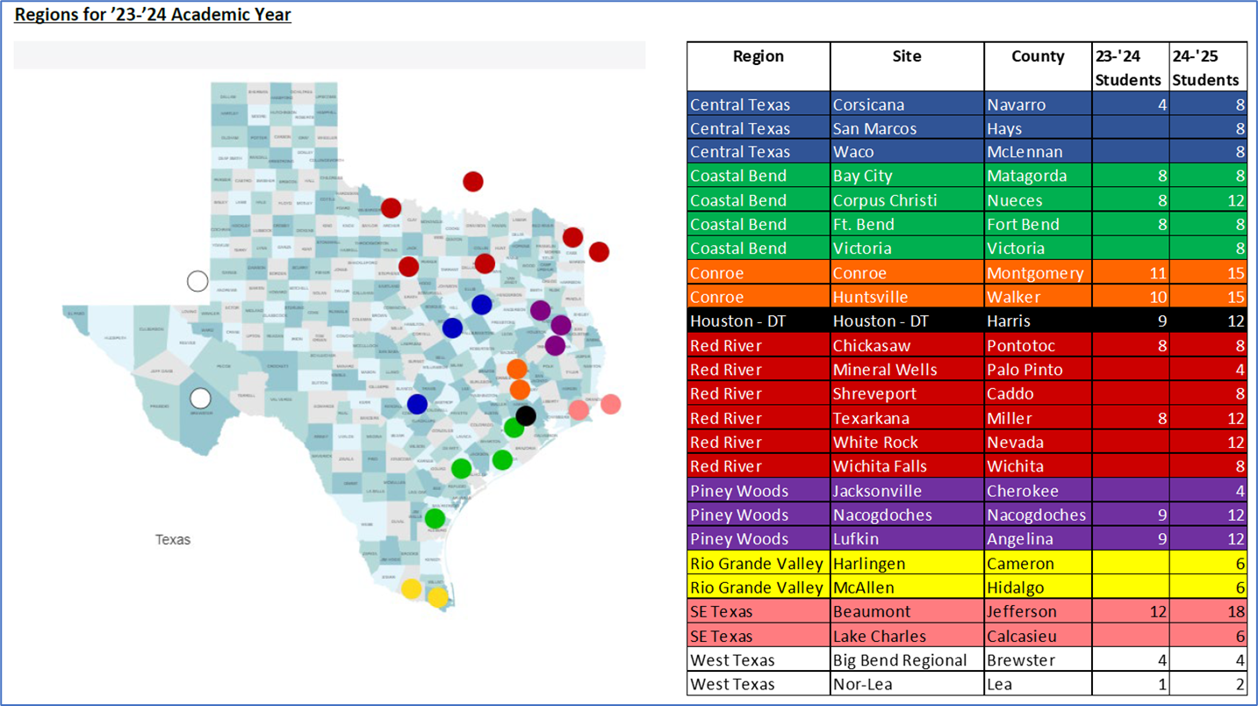
Supportive Data
Placement numbers and locations estimated and not finalized

Slide 11
Budget Request
#3 Budget Priority
What is the request?
#3 Budget Priority | Faculty
Aligned with Strategic Priority Goal | Strategic Priority 1 Goal 1: Recruit, retain, graduate, and empower students to drive sustainable growth
Amount Requested | $435,600
Frequency of Need | Recurring
Opportunity Statement | OPP and Primary Care Faculty- Increase current OPP position from FTE 0.5 to 1.0 and hire 1.0 FTE in Primary Care. For two years, SHSU-COM was placed on 'Heightened Monitoring' by the accreditation agency (COCA) due to insufficient faculty in the Department of Osteopathic Principles and Practices. With increasing class sizes and expansion of the clinic, the COM needs to add clinical faculty who are involved in hands-on and small group training as well as curricular oversight of clinical rotations.
Risk Statement | We would risk being put on probationary status by COCA for not meeting appropriate student teacher ratios for our accredited class size.

Slide 12
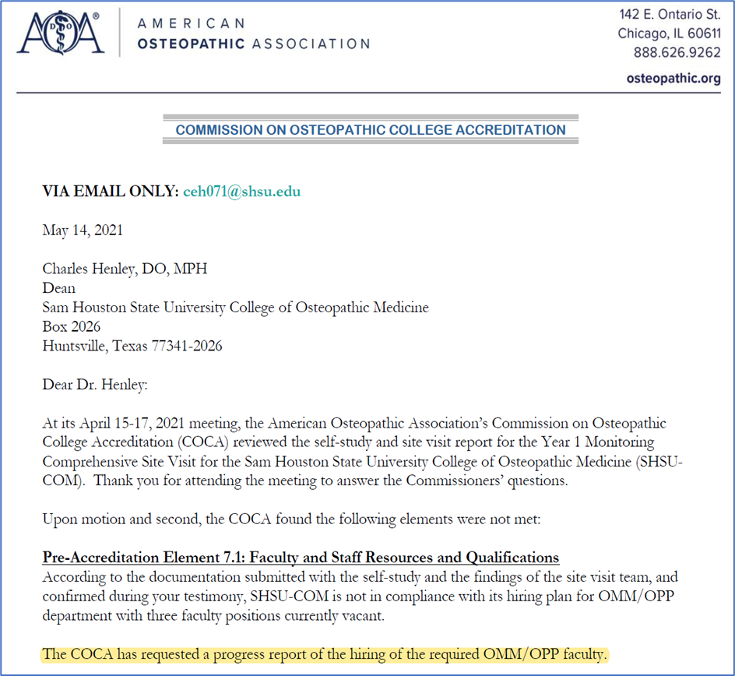
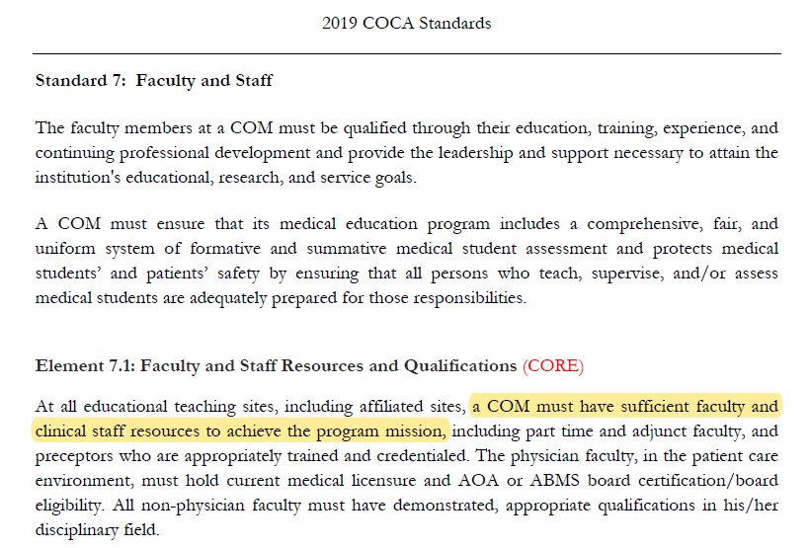
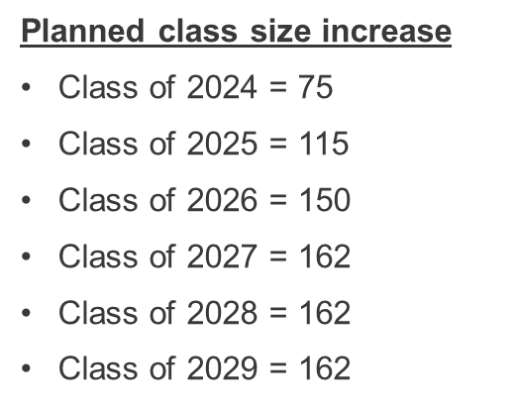
Supportive Data

Slide 13
Budget Request
#5 Budget Priority
What is the request?
#4 Budget Priority | Clinic Physicians
Aligned with Strategic Priority Goal | Strategic Priority 4 Goal 4.2 - Provide innovative ways to engage and serve the community
Amount Requested | $237,600 x 2 = $475,200
Frequency of Need | Recurring
Opportunity Statement | Clinic Physicians - In order for the SHSU Physician's Clinic to become financially viable and to provide continuity of care for patients, we need to have full time physicians providing primary care. This will form the basis for the establishment of residency programs and will support the educational faculty who see patients in the clinic on a part time basis.
Risk Statement | Without additional full-time clinicians, it will be difficult to provide high quality health care to the community, we will not be able to launch residency programs at that site, and the clinic will continue losing money.

Slide 14
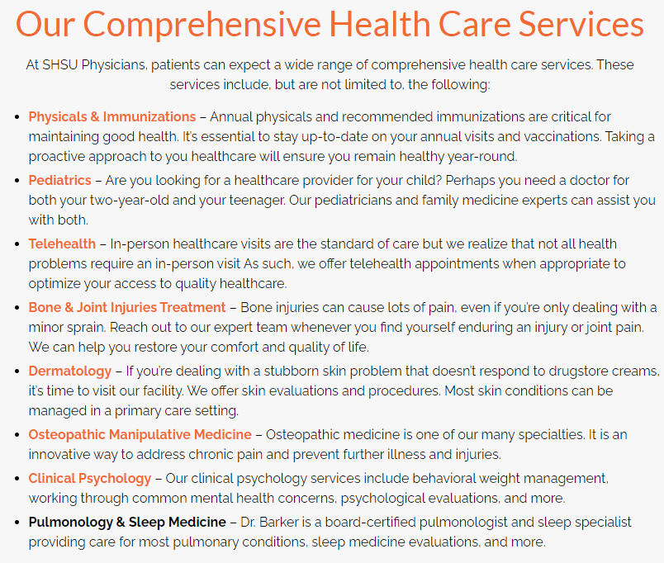
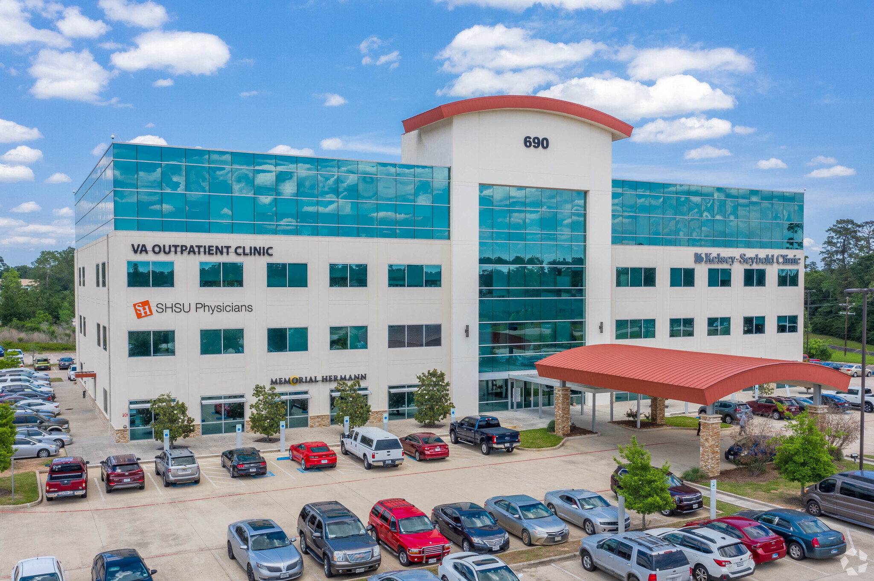
Supportive Data

Slide 15
Budget Request
#5 Budget Priority | Clinic – Lease and Operating Expenses
Aligned with Strategic Priority Goal | Strategic Priority 4 Goal 4.2 - Provide innovative ways to engage and serve the community
Amount Requested | $329,713
Frequency of Need | Recurring
Opportunity Statement | Increase in lease expense for new location. The SHSU Physicians Clinic is several miles away in a medical office building with close competition and no options to expand. Faculty find it difficult to commute back and forth to the clinic and the clinic was disengaged from the medical school. The new clinic site adjacent to the campus will elevate the stature of the medical school and university, allow space to grow and to establish residency programs, and allow growth of revenue generating add-ons such as laboratory and radiology. Increase in billing/credential expenses, medical supplies, outsourced marketing for new space, additional physicians and growing practice. The clinic is not financially viable with its current business plan. These expenditures are needed to provide appropriate resources for success of the clinic.
Risk Statement | Without this funding, we will have difficulty providing the appropriate quality of clinical education to our students and will need to outsource academic duties to non-faculty adjuncts. In addition, it will be difficult to attain financial viability for the clinic.
#4 Budget Priority
What is the request?

Slide 16
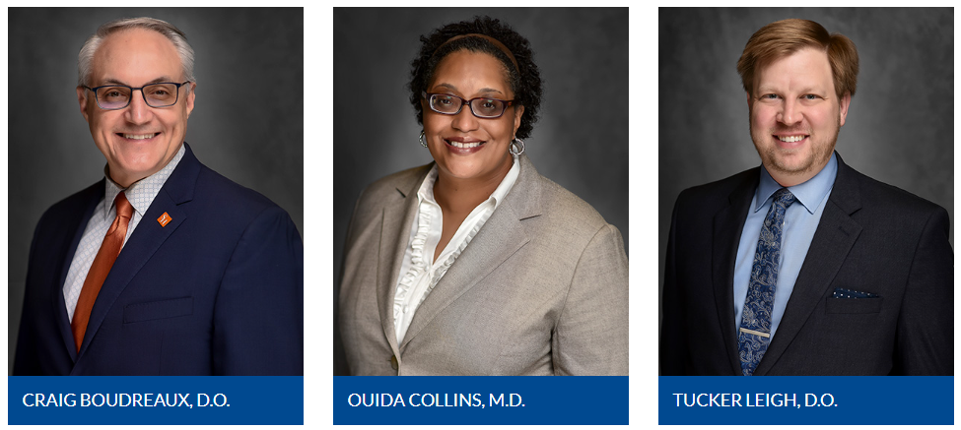
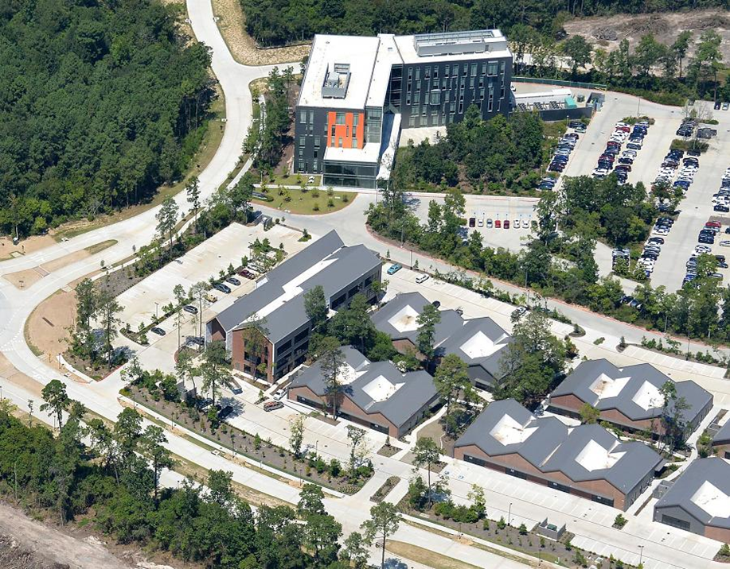
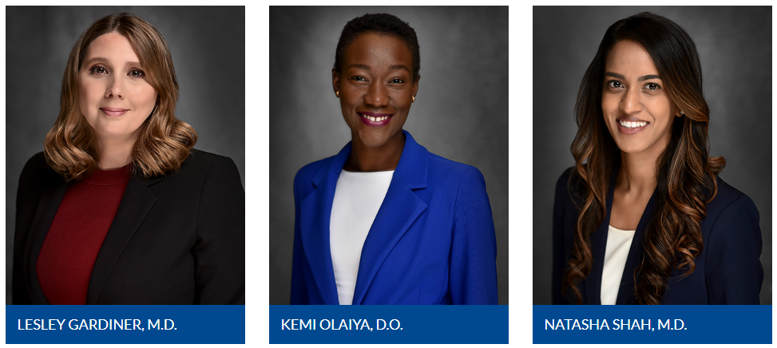
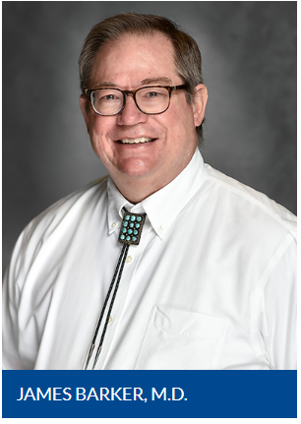
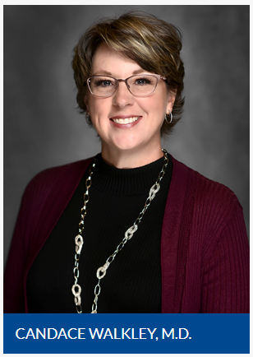
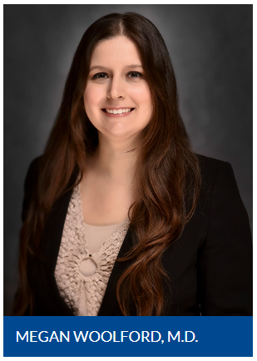
Supportive Data

Slide 17
Summary of Budget Requests
Payments to Hospitals, Preceptors and Regional Medical Directors | $1,024,969
Student Housing During Rotations | $174,169
OPP Faculty: $158,400 Primary Care Faculty: $277,200 | $435,600
Clinic Physicians X 2 | $475,200
SHSU Physicians Clinic Expenses (O&M) | $329,713
*Total Amount Requested | $ 2,439,651

Slide 18
Prospective “Big Ideas”
First successful Match and Graduation
Obtain full accreditation
Dual Degree Programs (DO-MPH, DO-MHA, DO-MBA)
New Residency Program Development with grants
Expansion of the SHSU Physicians Clinic

Slide 19
Questions?

